Slide 1

Cloud Adoption Framework for Azure Proven guidance and best practices that help you confidently adopt the cloud and achieve business outcomes.
Last updated: Nov 2022

Slide 2
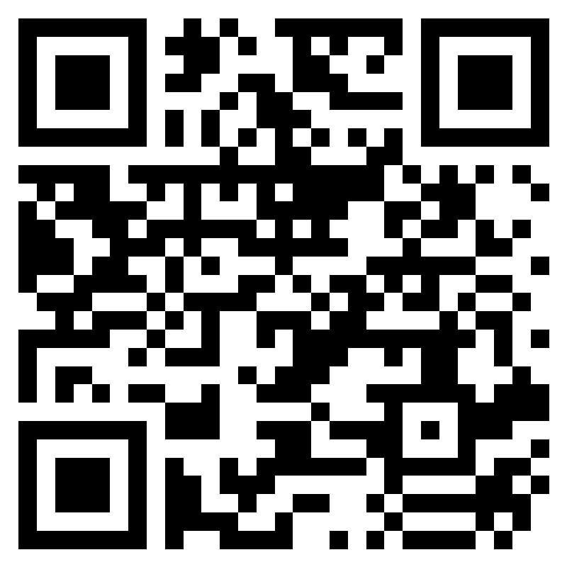

Slide 3
What’s happening around us

Slide 4
What is accelerating digital transformation
in CEE?
Covid
Cost of Utilities
War in Ukraine
Competition
Notes:
<Key point>: Digital Transformation is the evolution of business
Digital transformation embraces the necessity of change.
What kind of change are we talking about?
—optimization
—identifying and implementing efficiencies
There is no magic “efficiency” switch to flip.
It’s about a process of change—changing the foundation of how your business works.
Many of you already know if they don’t digitally transform and evolve, their businesses won’t survive.
And now, they’ve committed to making this transformation happen.
But companies need guidance during this challenging process—technical guidance that’s tailored to their industry and considers their business requirements and objectives.
<Transition>: Change is necessary in today’s competitive business climate. So, how do you implement changes to your business to be more efficient?

Slide 5
The question is no longer why, but how.

Slide 6
Change requires radical thinking.
…change is difficult.
We understand that.
Change impacts people, culture, and feels risky.
It requires leaders to adapt, take risks, and learn quickly.
Change requires a culture shift
within any organization,
and starts with you.
Notes:
<Key point>: change is hard—because it affects people, not just process.
The decision to commit to change is only the first step.
Whether evolving to meet increased market demand, or face tough foreign competition, change is inevitable.
Many business leaders already realize that change is much more than just swapping out technologies.
It’s an incremental process—evolving in how you’re doing business that affects culture company-wide—all your employees. And it starts with you, the business leader.
You know that the journey to the cloud is hard, but necessary to continue to grow in an evolving marketplace.
<Transition>: For businesses, it’s step-by-step path to modernization—and growth.

Slide 7
Modernization drives measurable ROI
Shifting from on-premises operations to the cloud favors the bottom line
Benefits (Three-Year)
$7.3M
Research findings¹ indicate organizations with Azure-mature tenure (three-years):
experience benefits of $13.1 million over three years versus costs of $2.3 million
benefits add up to a net present value (NPV) of $10.8 million and an ROI of 478%.
$3.0M
$1.9M
$927.1K
Avoided on-premises
Avoided on-premises
Income from new and
Income from new
infrastructure costs
FTE costs
larger online B2C sales
enterprise sales
1Forrester Total Economic Impact™ Study Commissioned By Microsoft, August 2019, The Total Economic Impact™ Of Microsoft Azure IaaS Cost Savings And Business Benefits Enabled By Azure Infrastructure-As-A-Service (IaaS)
Notes:
<Key point>: modernization drives measurable growth for your business.
Now, with the buy-in from your leadership team, you can lead the way to change—and modernization.
You might be thinking—“What’s in it for me, my business, and our bottom line?
There are a lot of growth benefits that come with change—and they are measurable.
You might be considering a hybrid cloud solution for your growing business.
Modernize some on-prem apps and move other apps to the cloud.
Moving to hybrid cloud solutions will save you on-premises hardware costs.
Leadership can allocate less funds to pay for reduced staffing at her on-premises datacenter.
You grow more online B2C sales—tapping into more computing resources to handle sudden peaks in demand.
It’s an evolution—and carefully planned, business-wide change of moving to the cloud.
<Transition>: Let’s look at how Azure enabled Dentsu Aegis to do more, and achieve more, with the cloud.

Slide 8
Overview: Microsoft Cloud Adoption Framework for Azure

Slide 9
Go faster. Stay in control. Deliver results. Over, and over, again. Using a business-first approach.
Best practices
Templates
People
Process
Technology
Documentation
Tools
Control & Stability
Speed &
Results
Align—business, people and technology strategy. Business is the driver; technology is the enabler.
Achieve—business goals with actionable guidance. If you can’t measure it, then it doesn’t count.
Deliver—fast results with control and stability.
Notes:
<Key point>: Change is more than adopting technology. It’s adapting how you do business.
The Microsoft Cloud Adoption Framework for Azure means changing how you do business—not just swapping out technology, but changing your enterprise, the culture behind it, and you too.
We share best practices from our employees, partners, and customers who have already undertaken the cloud journey.
The Cloud Adoption Framework brings together people, process, and technology—a strategy that’s aligned to your business goals.
Quickly—efficiently, and with actionable guidance, it provides guidance for your organization’s agile business transformation.
Leading people through change is difficult. It’s not just the technology that changes. It’s your people and processes too.
We can help guide you through.
<Transition>: How does the Cloud Adoption Framework work for your business?

Slide 10
Plan
An iterative* process that supports your business … as it evolves
Govern
Manage
Define strategy
*a repeatable process which delivers measurables results over and over again
Adopt
Ready
Notes:
<Key point>: An iterative process that supports your business needs.
We can help you on your cloud adoption journey.
We put the experience of employees, partners, and customers to work for you.
We work together with you—to build your plan for cloud adoption.
It starts with your vision.
Crystallize your vision for cloud adoption by working cross-functionally with your finance, marketing, sales, and HR departments.
Work to gain consensus on:
Clear motivations: Why are we adopting the cloud?
Defined business outcomes: What results do we expect to see from adopting the cloud?
Business justification: How will the business measure success?
We work with you to build an actionable cloud adoption plan with strategic (above) and tactical inputs such as defining your workloads and assets, aligning your organization, and readying necessary skills.
This cross-team effort is balanced out by the technical team, who will take this vision and execute technical deployment.
We recommend iterative planning to drive your cloud adoption effort—enabling your technical teams to move incrementally, in phases towards cloud adoption.
<move to the Ready phase to explain another example, to show iterative process, if necessary>
You plan will unite your organization in a cross-team initiative that, together, will forecast, budget, implement, and manage its success.
Our approach is Agile, and we consider security, governance, cost-optimization, and hybrid-cloud awareness by default.
Microsoft will work with you, learning how you do business—and help you adapt.
Your organization is changing—moving towards modernization, with challenging new markets, products, customer engagement.
We can help you get there.
<Transition>: What does a cloud adoption framework look like?

Slide 11
Microsoft Cloud Adoption Framework for Azure
The official version
Define strategy
Define business justification and expected outcomes
Plan
Align actionable cloud adoption plan to business outcomes
Ready
Prepare people, process and environment for change
Adopt
Migrate or Innovate
Implement desired changes across IT and business processes
Govern
Comply, control and secure
Manage
Operate and optimize
https://aka.ms/adopt/overview
Notes:
<Key point>: Cloud Adoption Framework—modular phases of adoption.
As your organization evolves, the Cloud Adoption Framework adapts to your business needs.
Each module in the diagram is an iterative phase that advances your business through the complete lifecycle of cloud adoption.
Customers can choose the phase best-suited to their degree of cloud adoption maturity. The Cloud Adoption Framework offers a guiding methodology to cloud adoption, with specific approaches to overcoming common blockers to cloud adoption in each module, such as “Define Strategy,” “Plan,”, etc.
The Cloud Adoption Framework offers the enterprise a modular framework of how to incrementally onboard to the cloud.
Cloud adoption shifts how companies obtain, make use of, and lock down their technology resources.
And—this kind of modular framework flips the model of how enterprises operate:
Transitions organizations to need-based consumption of technology resources
Change from cap-ex (capital expenditure) to op-ex (operating expenditure) model
Cloud model assumes security, governance, cost-optimization, and hybrid cloud by default
Develop a future-ready workforce—developing and deploying cloud skill readiness organization-wide
As an organization progresses through the Cloud Adoption Framework, what are the main goals of each methodology of “Define Strategy,” “Plan,” you can focus efforts on?
<Transition>: Let’s look at some possible motivations for cloud adoption, and what some common blockers are that the Cloud Adoption Framework can help you resolve.

Slide 12
Migrate existing workloads
Define Strategy
Plan
Ready
Adopt
1
3
Gather data and analyze assets and workloads
6
Build skills readiness plan
8
Migrate first 10 workloads
Align stakeholders
2
Align partner support
7
Deploy an aligned landing zone
4
Make a business case
5
Create migration plan
Govern
Manage
9
Hand-off production workloads to cloud governance
10
Hand-off production workloads to cloud operations
aka.ms/adopt/getstarted-migrate
Notes:
<Key point>: Here are the iterative steps that enable the customer journey of Accelerate migration.
Step 1: Align stakeholders
Gain agreement on migration motivations.
Capture desired business outcomes and measure them with metrics.
Step 2: Align partner support
Microsoft Partners, services, and programs are available to support your migration journey.
Step 3: Gather data and analyze assets and workloads
Inventory existing systems: Validate the business case by using data about the current state environment.
Incremental rationalization: Perform quantitative analysis of that data and a deep qualitative assessment of the highest priority workloads.
​Step 4: Make a business case
Evaluate the initial high-level return from a potential cloud migration.
Ensure that all stakeholders align on a data driven decision whether overall adoption of the cloud is a wise business decision.
Step 5: Create a migration plan
Cloud adoption plan template: Deploy the basic template.
Workload alignment: Define workloads in the backlog.
Effort alignment: Align assets and workloads in the backlog to clearly define effort for prioritized workloads.
People and time alignment: Establish iteration, velocity (people's time), and releases for migrated workloads.
Step 6: Build a skills readiness plan
Quickly evaluate required and existing skills of the team, to better understand what skill requirements should be addressed.
Step 7: Deploy an aligned landing zone
Choose a landing zone: Find the right approach to deploying a landing zone based on your adoption pattern, then deploy that standardized code base.
Expand your landing zone: Regardless of the starting point, identify gaps in the deployed landing zone to add required components for resource organization, security, governance, compliance, and operations.
Step 8: Migrate your first 10 workloads
(Iterative process—repeated every migration).
Assess workloads: Assess each batch of workloads to evaluate cost, architecture, and deployment tooling.
Deploy workloads: Replicate functionality in the cloud using IaaS, PaaS, cloud-native, or other modernization solutions.
Release workloads: Test, optimize, document, and review. Release by handing off for governance, management, and security.
Step 9: Hand off production workloads to cloud governance
Governance approach: Outline a process for thinking about corporate policy and processes. Then build the disciplines required to deliver on governance across your cloud enterprise adoption efforts.
Initial governance foundation: Understand the Identity Baseline discipline, Security Baseline discipline, and Deployment Acceleration discipline, required to create a governance minimum viable product (MVP) to serve as the foundation for all adoption.
Step 10: Hand off production workloads to cloud operations
Establish a management baseline
Define business commitments
Expand the management baseline
Get specific with advanced operations
​
<Transition>: What if you want to Build new products and services?

Slide 13
Build new products and services
Define Strategy
Plan
Ready
Adopt
1
3
Gather data and analyze assets and workloads
7
Deploy an aligned landing zone
8
Innovate in the cloud
Document the business strategy
2
Evaluate business justification
4
Plan asset migration
Govern
Manage
5
Align governance requirements to adoption plan
6
Define operational needs and business commitments
aka.ms/adopt/getstarted-buildnew
Notes:
​<Key point>: Here are the iterative steps that enable the customer journey of Build new products and services.
Step 1: Document the business strategy
Motivations: Strategic align, seek consensus on motivations for the migration effort. Understanding and categorizing motivations and common themes from various stakeholders across business and IT.
Business outcomes: After motivations are aligned, capture the desired business outcomes, using clear metrics to measure overall transformation.
Building a cloud migration business case: Start to develop a migration business case with clear guidance on formulas and tools to help business justification.
Step 2: Evaluate the business justification
Business justification: Before evaluating opportunities to innovate in the cloud, complete a high-level business justification to establish stakeholder alignment for the overall adoption plan.
Business value consensus: Identify how that innovation can align to and drive business value.
Step 3: Gather data and analyze assets and workloads
Inventory existing systems: Validate the business case by using data about the current state environment.
Incremental rationalization: Perform quantitative analysis of that data and a deep qualitative assessment of the highest priority workloads.
​Step 4: Plan for migration of dependent assets
Cloud adoption plan template: Deploy the basic template.
Workload alignment: Define workloads in the backlog.
Effort alignment: Align assets and workloads in the backlog to clearly define effort for prioritized workloads.
People and time alignment: Establish iteration, velocity, and releases for the workloads.
Step 5: Align governance requirements to your adoption plan
Governance approach: Outline a process for corporate policy and processes. Build the disciplines required to deliver on governance across cloud enterprise efforts.
Define corporate policy: Identify and mitigate business risks.
Step 6: Define operational needs and business commitments
Define business commitments: Create business alignment in cloud management.
Get specific with advanced operations: Go beyond your management baseline and apply design principles and advanced operations. If advanced operations are required to support your operations needs, evaluate the business commitments to determine operational responsibilities for both teams.
Step 7: Step 7: Deploy an aligned landing zone
Choose a landing zone: Deploy a landing zone based on your adoption pattern, then deploy that standardized code base.
Expand your landing zone: Regardless of the starting point, identify gaps in the deployed landing zone to add required components for resource organization, security, governance, compliance, and operations.
Step 8: Innovate in the cloud
Business value consensus: If more than three months have passed since the last business value consensus, or if never completed, Identify how innovation can align to and drive business value.
Azure innovation guide: Use the Azure innovation guide to speed up the deployment of innovative solutions by understanding the tools and processes to help build a minimum viable product (MVP).
Innovation best practices: Combine Azure services to create a toolchain for digital invention.
Feedback loops: Develop improved feedback loops to quickly deliver impactful innovations to your customers.
​
<Transition>: What if you want to Unblock environmental design and configuration?​

Slide 14
Unblock environment design and configuration
Define Strategy
Plan
Ready
Adopt
1
Document the business strategy
2
Assess digital estate
4
Deploy first landing zone
3
Create cloud adoption plan
7
Expand the landing zone
Govern
Manage
5
Deploy initial governance
foundation
6
Implement an operations baseline
aka.ms/adopt/getstarted-environment
Notes:
<Key point>: Here are the iterative steps that enable the customer journey of Unblock environmental design and configuration.
Step 1: Document the business strategy
Motivations: Strategic align, seek consensus on motivations for the migration effort. Understanding and categorizing motivations and common themes from various stakeholders across business and IT.
Business outcomes: After motivations are aligned, capture the desired business outcomes, using clear metrics to measure overall transformation.
Building a cloud migration business case: Start to develop a migration business case with clear guidance on formulas and tools to help business justification.
Step 2: Assess the digital estate
Inventory existing systems: Validate the business case by using data about the current state environment.
Incremental rationalization: Perform quantitative analysis of that data and a deep qualitative assessment of the highest priority workloads.
Step 3: Create a cloud adoption plan
Cloud adoption plan template: Deploy the basic template.
Workload alignment: Define workloads in the backlog.
Effort alignment: Align assets and workloads in the backlog to clearly define efforts for prioritized workloads.
People and time alignment: Establish iteration, velocity, and releases for the migrated workloads.
​Step 4: Deploy the first landing zone
Choose a landing zone: Find the right approach to deploying a landing zone based on your short-term adoption plan, then deploy that standardized code base.
Expand your landing zone: Don't attempt to meet long-term governance, security, or operation constraints yet, unless they're required to support the short-term adoption plan.
Step 5: Deploy an initial governance foundation
Governance approach: Outlines a process for thinking about corporate policy and processes, then build the disciplines required to deliver on governance across cloud enterprise adoption efforts.
Governance benchmark tool: Find gaps in your current state so that you can plan for the future.
Initial governance foundation: Understand the Identity Baseline discipline, Security Baseline discipline, and Deployment Acceleration discipline required to create a governance minimum viable product (MVP) to serve as the foundation for all adoption.
Step 6: Implement an operations baseline
Expand the management baseline: Establish actionable best practices for operational management in the cloud.
Define business commitments: Create business alignment in cloud management.
Expand the management baseline: Establish actionable best practices for operational management.
Get specific with advanced operations: Go beyond your management baseline and apply design principles and advanced operations.
Step 7: Expand the landing zone
Refactor landing zones: Modify or restructure source code to optimize the output, accelerate migration, and remove common blockers.
Test-driven development of landing zones: Use test-driven DevOps processes to improve the quality of new features and improvements in code-based solutions.
Expand landing zone governance: Improve the landing zone governance foundation to integrate cost controls, establish basic tooling to allow for scale, and will make it easier for the cloud governance team to deliver on the Five Disciplines of Cloud Governance.
Expand landing zone operations: Use landing zone governance best practices with naming and tagging standards, cost tracking across workloads, scaling with multiple subscriptions, and organizing and managing subscriptions.
Expand landing zone security: Use landing zone best practices to protect data and assets, building on the test-driven development approach to landing zones, expanding or refactoring the landing zone to account for heightened security requirements.
​
<Transition>: Let’s look at the Get Started guides in Microsoft Cloud Adoption Framework Documentation
​

Slide 15
CAF Simplified

Slide 16
Microsoft Cloud Adoption Framework for Azure
The JV version
Define strategy
Why Azure?
Why are we even talking about this?
What do you expect out of it?
How will you measure success?
Any requirements (SLA, RTO, RPO, Regulatory, etc.)
Timeline?
Plan
Open Pandora’s box – discover, assess, rationalize
Define migration waves based on strategy
Plan to skill’em up
Ready
Time for change
Skill’em up
Build a rock-solid foundation
Update some processes
Adopt
Migrate or Innovate
Start implementing the expected business outcomes.
Build, measure, learn.
Operate
Govern & Manage
Operate and optimize
Comply, control and secure
https://aka.ms/adopt/overview
Notes:
<Key point>: Cloud Adoption Framework—modular phases of adoption.
As your organization evolves, the Cloud Adoption Framework adapts to your business needs.
Each module in the diagram is an iterative phase that advances your business through the complete lifecycle of cloud adoption.
Customers can choose the phase best-suited to their degree of cloud adoption maturity. The Cloud Adoption Framework offers a guiding methodology to cloud adoption, with specific approaches to overcoming common blockers to cloud adoption in each module, such as “Define Strategy,” “Plan,”, etc.
The Cloud Adoption Framework offers the enterprise a modular framework of how to incrementally onboard to the cloud.
Cloud adoption shifts how companies obtain, make use of, and lock down their technology resources.
And—this kind of modular framework flips the model of how enterprises operate:
Transitions organizations to need-based consumption of technology resources
Change from cap-ex (capital expenditure) to op-ex (operating expenditure) model
Cloud model assumes security, governance, cost-optimization, and hybrid cloud by default
Develop a future-ready workforce—developing and deploying cloud skill readiness organization-wide
As an organization progresses through the Cloud Adoption Framework, what are the main goals of each methodology of “Define Strategy,” “Plan,” you can focus efforts on?
<Transition>: Let’s look at some possible motivations for cloud adoption, and what some common blockers are that the Cloud Adoption Framework can help you resolve.

Slide 17
Microsoft Cloud Adoption Framework for Azure
The simplified JV version
Define strategy
Why are we doing this and what will success look like?
Plan
What is this all about and how do we get there?
Ready
Foundations rock!
Everyone loves skilling.
Adopt
Crawl → Walk → Fall → Walk → Run
Operate
Govern & Manage
Keep on running

Slide 18
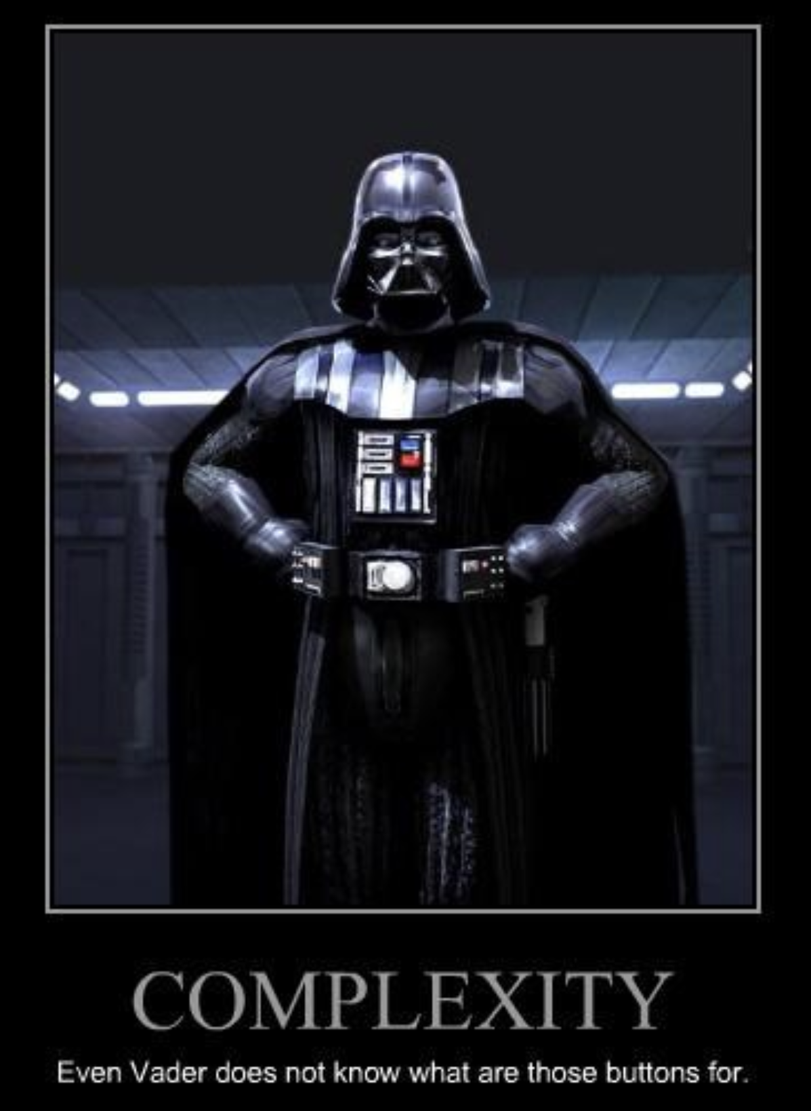
BC* era Migrations be like…..
*Before CAF

Slide 19
Streamline migrations with CAF & WAF
Business strategy
Migration assessment and execution
Security and compliance
Cloud operations
High level business strategy
Key stakeholder sign off
Migration funding committed
Migration and Operation Partner
Assessment
Workload alignment
Migration strategy
Financial analysis
Migration execution
Specific migration workloads committed
Azure administration
Security
&
Governance
Networking Landing Zone
DevOps operation & automation
Identify Next Projects
Text
Text
Text
Text
Text
Text
Text
Text
Text
Text
Text
Text
Text
Text
Text
Text
Text
Text
Text
Text
Text
Text
Text
Text
Text
Text
Text
Text
Text
Text
Text
Text
Text
Text
Text
Text
Text
Text
Text
Text
Text
Text
Text
Text
Partner support
TCO/ business case
Technical skilling
Landing zone design
Just follow the framework!
Discovery and assessment
Notes:
Real life migrations can be complex and messy to navigate.
This is from our FTA team which has been working with many many customers…

Slide 20
Pro Tips
CAF is by the field, for the field. Everyone is contributing. MSFT, Partners, Customers.
CAF is battle-tested guidance plus best practices that help you confidently adopt Azure and achieve business outcomes.
Anti-patterns. Avoid them as much as possible. If you don’t know what they are, RT$M☺
A strategy with clearly defined & measurable business outcomes is a must-have. You can’t adopt Azure without it. No strategy = nearly-guaranteed failure.
Landing Zones are no longer optional. Not all foundations are equal. You can never go wrong with the Azure Landing Zone Conceptual Architecture. Use it to accelerate adoption by months.
Focus on design disciplines, considerations and recommendations. Don’t forget about trade-offs. Be a trusted advisor.
Deploy a well-managed, well-governed, highly modular, super-scalable Azure environment in minutes. Not days, not weeks, not months – in minutes (ok, maybe hours).
Customers hate customizations. Customizations break repeatability. Customizations can be expensive.
You can’t have Well Architected workloads without adopting the CAF methodology,
Don’t try to re-invent the wheel. But do make it better by sharing feedback.

Slide 21
Tools, templates, and assessments

Slide 22
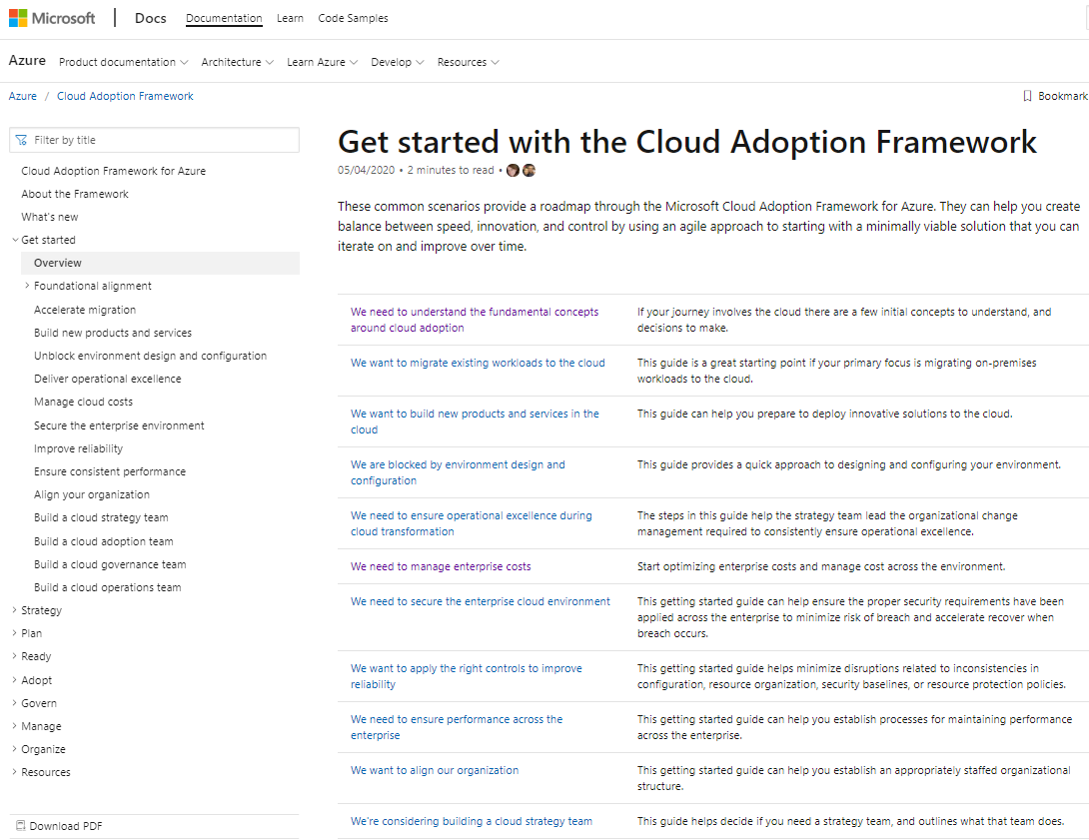
Find your path—get started on your journey
Use the Get Started Guides as your roadmap through the Cloud Adoption Framework to overcome common blockers
Notes:
<Key point>: Find more Get Started guides in Microsoft Cloud Adoption Framework Documentation
<Transition> There are a variety of tools, templates and assessments that will support your path to digital transformation; we will now look at a high-level overview of those resources

Slide 23
Tools, templates, and assessments
Define strategy
Plan
Ready
Adopt
Cloud journey tracker
Business outcome template
Azure DevOps demo generator
Cloud adoption plan template
Azure setup guide
Readiness checklist
Naming and tagging tracking template
Landing zone blueprints
Strategic migration assessment and readiness tool (SMART)
Azure migration guide
Azure innovation guide
Govern
Manage
Governance benchmark
Governance process template
Cost Management process template
Deployment acceleration process template
Identity process template
Resource consistency process template
Security baseline process template
Microsoft Azure Well-Architected Review
Best practices source code
Operations management workbook
aka.ms/adopt/tools-templates
Notes:
<Key point> We have tools, assessments, and other assets to support your cloud adoption journey.
<Transition> Although the tools, templates, and assessments enable you to manage your own journey, not everyone wants to do this alone. Let's talk about the role of Microsoft Partners - and how they can lighten the load.

Slide 24
Questions….. Don’t be shy. The more you ask, the more you learn

Slide 25
Thank You

